Slide 1
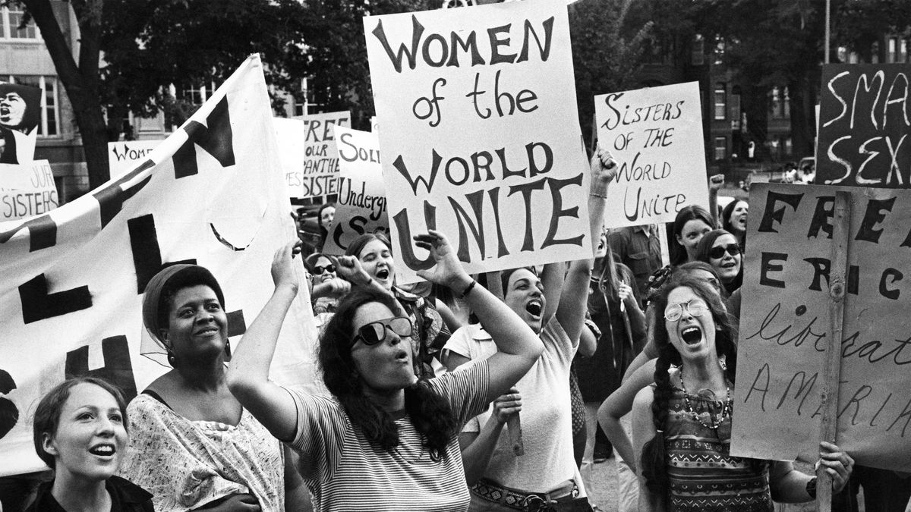
Feminism
Figure 1. Protest (Vox 2019)
Lance, Humera, Mankirat and Karan

Slide 2
What is Feminism?
So….

Slide 3
1st Wave Feminism
It came into existence in the late 19th century and during the early 20th century.
It emerged out of an 'environment of urban industrialism and liberal, socialist politics’. (Rampton 2015)
The main aim was to empower women and as a chance to open up new opportunities for women. For example, it allowed women the right to vote.
First wave feminism officially came into existence in 1848 at the Seneca Falls Convention. Three hundred men and women protested for equality for women.

Slide 4
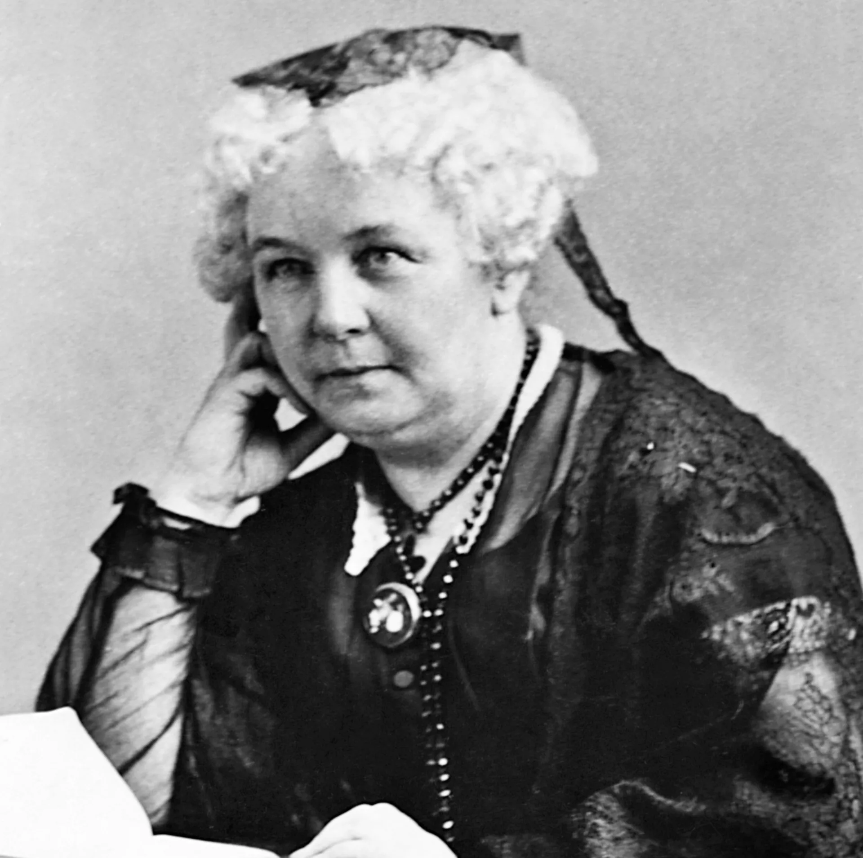
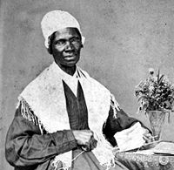
Elizabeth Cady Stanton (1815-1902)
Figure 2. Stanton (DK Find Out 2019)
A key figure associated with the women's rights and suffrage movements.
Elizabeth Cady Stanton was key in drafting the Seneca Falls Declaration which outlined new movement's, ideology and political strategies.
Figure 3. Truth (New World Encyclopedia 2019)
Advocate for women's rights in the 19th century.
Truth demanded in a speech 'Ain't I a woman?', demanding the rights and empowerment for Women.
Sojourner Truth (1797-1883)

Slide 5
2nd Wave Feminism
The second wave of feminism started around the 1960’s and lasted up until the 1980’s (Feminism in India 2018)
It was primarily a reaction to women returning to their roles as housewives and mothers after the end of the Second World War.
This was because men had returned from the defence forces and re-joined the work force (Feminism In India 2018)
Many men, who came back and retook their old jobs , also were given higher salaries than women, further highlighting this inequality (Feminism in India 2018)
Women had become independent during the war and had no intentions of becoming subjugated wives again and resume these roles which further brought about the second wave of feminism (Feminism in India 2018)
Figure 4. Feminism Symbol Black and pink (Wikimedia Commons 2019)

Slide 6
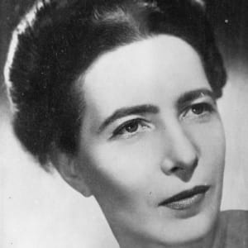
Feminist critics-Simone De Beauvoir
World War II brought about some writers that had begun to question how women in society were perceived, particularly as the war showed that women made valuable contributions (Daily History 2019)
In 1949, Simone De Beauvoir published ‘The Second Sex’, a ground-breaking book that questioned how society viewed women and the role in which they played (Daily History 2019)
In her work, Beauvoir writes, “one is not born, but rather becomes a woman”. This quote represents how society fosters the idea of what a woman should do and act (Daily History 2019)
The book simply questioned that women were allowed to break out of their gender roles during World War II, so why are they being forced to perpetuate roles that saw as being secondary to men (Daily History 2019)
Figure 5. De Beauvoir (Biography 2019)

Slide 7
Carol Hanisch
She published an essay in 1970 titled “the personal is political”. Hanisch argued that everything was political, including the division of household labour and gender roles (Feminism in India 2018).
If a woman decided to have an abortion and get a job as a woman in a male-dominated society, that decision has political consequences and became politicised in society (Feminism in India 2018).
Women had to bring their private, household problems into the public sphere because issues were politicised and had consequences far outside of an individual (Feminism in India 2018).
The second wave feminist movement proved to be a major social transition , such as women’s participation in the labour force, and increased prosperity (Daily History 2019).
Figure 4. Feminism Symbol Black and pink (Wikimedia Commons 2019)

Slide 8
What is Post Feminism?
Emerged in the 1980s as a reaction to the movements of the second wave.
The definition of post-feminism remains unclear.
Gamble (2001) discusses several possible definitions of post feminism:
There is a suggestion that the previous feminist movements have been completed or are now obsolete and no longer relevant.
Alternatively, post-feminism is a continuation of the previous feminist movements that builds upon what has come before it.
Figure 6. Feminism symbol (Wikimedia Commons 2019)

Slide 9
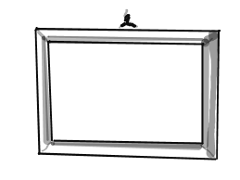
What are the Features of Post Feminism?
“Mainstream emphasis on femininity as a bodily property” (Dosekun 2015 cites Gill 2007).
“Imperative for women to (hetero)sexually self-objectify” (Dosekun 2015 cites Gill 2007).
“An insistent casting of women’s actions as freely chosen and self-pleasing” (Dosekun 2015 cites Gill 2007).
Depoliticization of women’s issues (Genz and Brabon 2009).
Focus on ‘she’ rather than ‘we’ (McRobbie 2004).
individualistic
Attempts to deconstruct stereotypes and gender roles for both men and women.
Refutes the female victimhood that characterised the previous waves.
Figure 7. Frame (Wikimedia Commons 2019)
Figure 8. Scale (Wikimedia Commons 2o19)

Slide 10
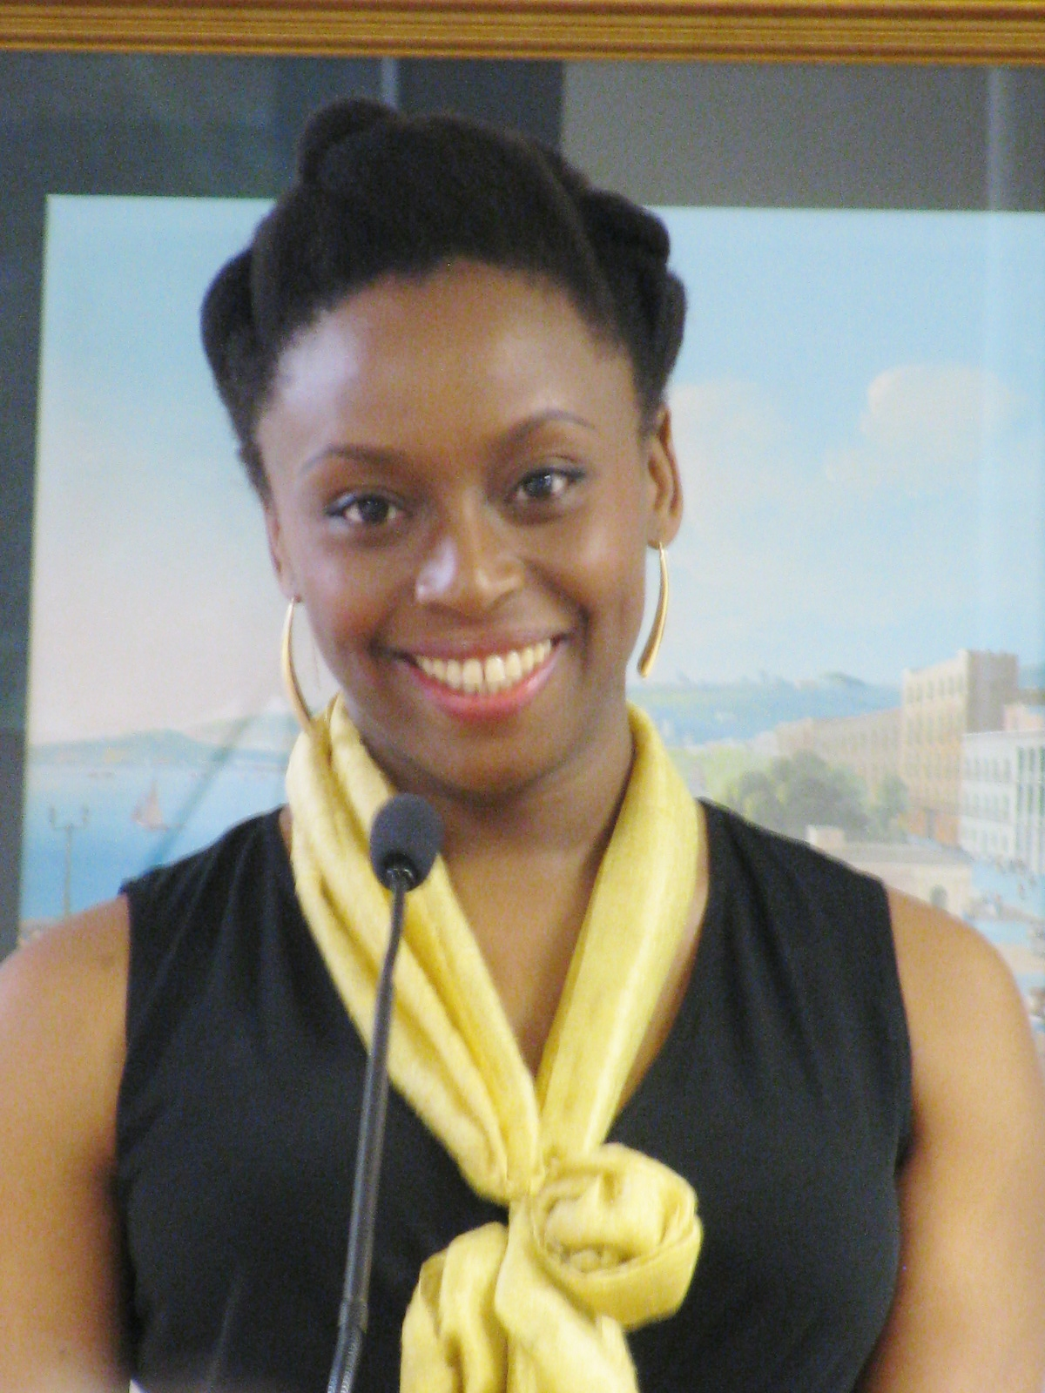
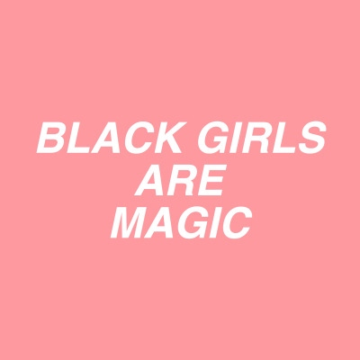
Post Feminism vs. Black Feminism
Post-feminism has been heavily criticised.
It has been regarded as a “con” created by the media (Gamble 2001).
Doskun (2015 cites Tasker and Negra 2007) claims that those that benefit from post-feminism are “white and middle class by default”.
Black feminism attempts to acknowledge and celebrate the contributions of women of colour to society and literature (Christian et al. 2007).
Unlike post-feminism, black feminism takes into account inequalities in race and social class that hinder some women.
In literature, black feminists “pursue themselves as subjects” rather than viewing themselves as subordinates or hybrids in an attempt to “reaffirm their existence” ( Christian et al. 2007).
Key figures: Chimamanda Ngozi Adichie and Bell Hooks
Figure 9. Poster (Wikimedia Commons 2019)
Figure 10. Chimamanda (Wikimedia Commons 2019)

Slide 11
King Lear
‘On 26 November 1607 an entry was made in the Stationers' Register for a play called King Lear, naming its author as William Shakespeare’ (Royal Shakespeare Company).
The play focuses on a King who wants to divide his kingdom between three of his daughters. However, in order for him to do this he asks his daughters express how much they love him.
As the play unravels, family relationships begin to crack. This is one of the main themes that is present throughout this play, along with betrayal, jealously and greed.
Figure 11. King Lear (Bloomsbury 2019)

Slide 12
King Lear
The way the play King Lear relates to feminism is by the way Cordelia, Goneril and Regan rebel against their father, the King. All of the women in this play go against the stereotypical way of how a woman during the 17th Century should behave.
Cordelia does this at the beginning of play as she does not compete with her sisters when asked by her father to show how much they love him. She finds this unnecessary as the father daughter relationship they have should already show how much love she has for him. This is an example of how Cordelia is not acting like a passive woman who does what she is told. As a result, Cordelia then gets pushed away by her father.
Regan and Goneril at the start of play conforms to the passive role of doing as they are told when they were asked to express their love for their father. However, throughout the play, their agenda becomes evident as they were plotting to take everything away from their father. Their father may be the king but he seems to lose his power and authority when his daughters turn against him.
Figure 11. King Lear (Bloomsbury 2019)

Slide 13
King Lear
Simone De Beauvoi’s ‘The Second Sex’
This c0ncept is relevant to this play. The reason for this is because of the way the daughters are treated at the beginning of the play. They are expected to express their love for their father in order for him to divide his kingdoms between them. They are not seen as equal to men as men wouldn't need to do this. They would have direct access to the kingdoms.
Figure 11. King Lear (Bloomsbury 2019)

Slide 14
references
CHRISTIAN, B., BOWLES, G., FABI, M. anD G, KEIZER, A.R. (2007). NEW BLACK FEMINIST CRITICISM, 1985-2000. URBANA: UNIVERSITY OF ILLINOIS PRESS Daily History (2019). What was the Second Wave Feminist Movement? [online] available from
<https://dailyhistory.org/What_was_the_Second_Wave_Feminist_Movement%3F> [12 March 2019]
DK Find Out (2019). Elizabeth Cady Stanton [online] available from <https://www.dkfindout.com/us/history/womens-suffrage-in-america/elizabeth-cady-stanton/> [12 March 2019]
DOSEKUN, S. (2015). FOR WESTERN GIRLS ONLY? POSTFEMINISM AS TRANSNATIONAL CULTURE [ONLINE] 15 (6), 960-975. AVAILABLE FROM <HTTP://SRO.SUSSEX.AC.UK/63369 > [12 MARH 2019] Feminism in India (2019). Intersectional Feminism- Desi Style! [online] available from <https://feminisminindia.com/2018/04/25/summary-second-wave-of-feminism/> [12 March 2019]
GAMBLE, S. (2001). THE ROUTLEDGE COMPANION TO FEMINISM AND POSTFEMINISM. 2ND EDN. NEW YORK: ROUTLEDGE. GENZ, S. and BRABON, B.A. (2009). POSTFEMINISM : CULTURAL TEXTS AND THEORIES. EDINBURGH: EDINBURGH UNIVERSITY PRESS. MCROBBIE, A. (2004). POST‐FEMINISM AND POPULAR CULTURE, FEMINIST MEDIA STUDIES [ONLINE] 4 (3), 255-264, AVAILABLE FROM <WWW.TANDFONLINE.COM> [12 MARCH 2019]
New World Encyclopedia (2019). Sojourner Truth [online] available from <http://www.newworldencyclopedia.org/entry/Sojourner_Truth> [12 March 2019]
Pacific University (2019). Four Waves Feminism [online] available from <https://www.pacificu.edu/about/media/four-waves-feminism> [12 March 2019]
Royal Shakespeare Company (2019). King Lear [online] available from <https://www.rsc.org.uk/king-lear/about-
the-play/dates-and-sources> [10th March 2019]
The Stockton Postcolonial Project (2019). The Stockton Postcolonial Studies Project Home [online] available from
<https://blogs.stockton.edu/postcolonialstudies/domesticity-and-kitchens/american-feminism/first-wave-feminism/> [12March 2019]
Shelley, M. (2014) .Frankenstein, Open Road Media [online] available from: <https://ebookcentral.proquest.com/lib/coventry/reader.action?docID=1799658>. [13 March 2019]
Women’s History (2019). Elizabeth Cady Stanton [online] available from https://www.womenshistory.org/education-resources/biographies/elizabeth-cady-stanton [12 March 2019]

Slide 15
LIST OF FIGURES Biography (2019). File: Simone-de-beauvoir [online] available from <https://www.biography.com/people/simone-de-beauvoir-9269063> [12 March 2019]
Croall, J. (2015). FILE: King Lear Book Cover [online] available from <https://www.bloomsbury.com/uk/performing-king-lear-9781474223874/> [12 March 2019]
Drury University (2019). FILE: Picture1.jpg [online] available from <
<http://humanities.drury.edu/wp-content/uploads/2016/01/Picture1.jpg> [12 March 2019]
Wikimedia Commons (2019). FILE: Black and Pink Feminism Symbol.png [online] available from <https://commons.wikimedia.org/w/index.php?title=Special:Search&search=feminist+symbol&fulltext=1&profile=default#/media/File:Pink-and-Black_Feminist_Symbol.png> [12 March 2019]
WIKIMEDIA COMMONS (20190). FILE:
BLACK_GIRLS_ARE_MAGIC.JPG [ONLINE] AVAILABLE FROM <HTTP://WWW.WIKIMEDIACOMMONS.COM> [12 March 2019]
WIKIMEDIA COMMONS (2019). FILE: CHIMAMANDA_NGOZI_ADICHIE_9374.JPG [ONLINE] AVAILABLE FROM <HTTP://WWW.WIKIMEDIACOMMONS.COM> [12 March 2019]
WIKIMEDIA COMMONS (2019). FILE: GENDER_EQUALITY_(6066)_-_THE_NOUN_PROJECT.SVG [ONLINE] AVAILABLE FROM <HTTP://WWW.WIKIMEDIACOMMONS.COM> [12 March 2019]
WIKIMEDIA COMMONS (2019). FILE: PICTURE_FRAME_ICON.PNG [ONLINE] AVAILABLE FROM <HTTP://WWW.WIKIMEDIACOMMONS.COM> [12 March 2019]
Vox (2019) FILE: Feminism-waves-explained-first-second-third-fourth [online] available from
<https://www.vox.com/2018/3/20/16955588/feminism-waves-explained-first-second-third-fourth> [12 March 2019]

