Slide 1


A Transfeminist Analysis of the Lives of Trans Women in Contemporary Fiction
Lance Honeghan
Student ID: 8692522

Slide 2
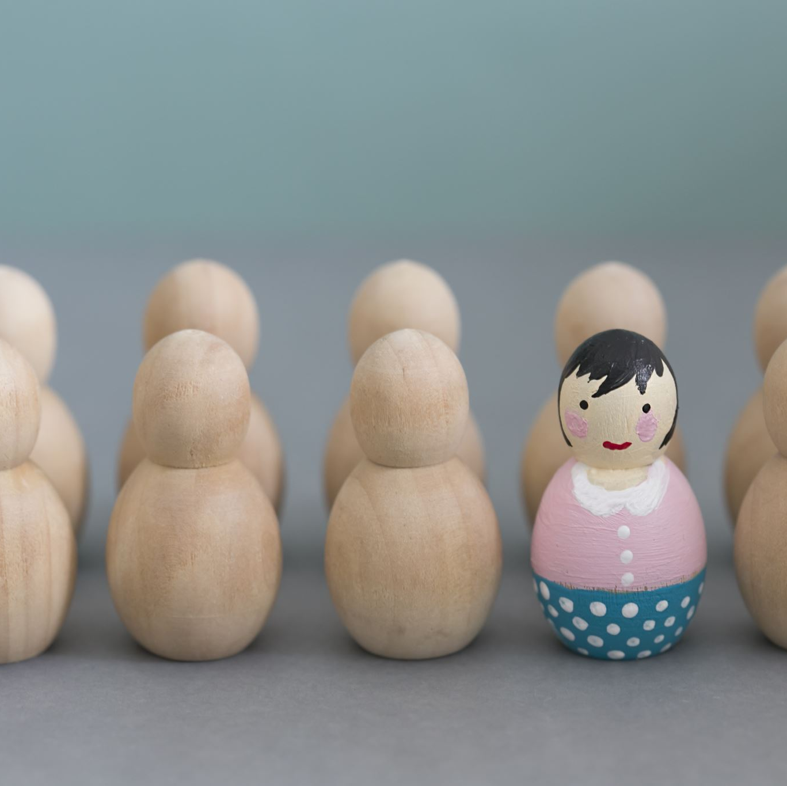
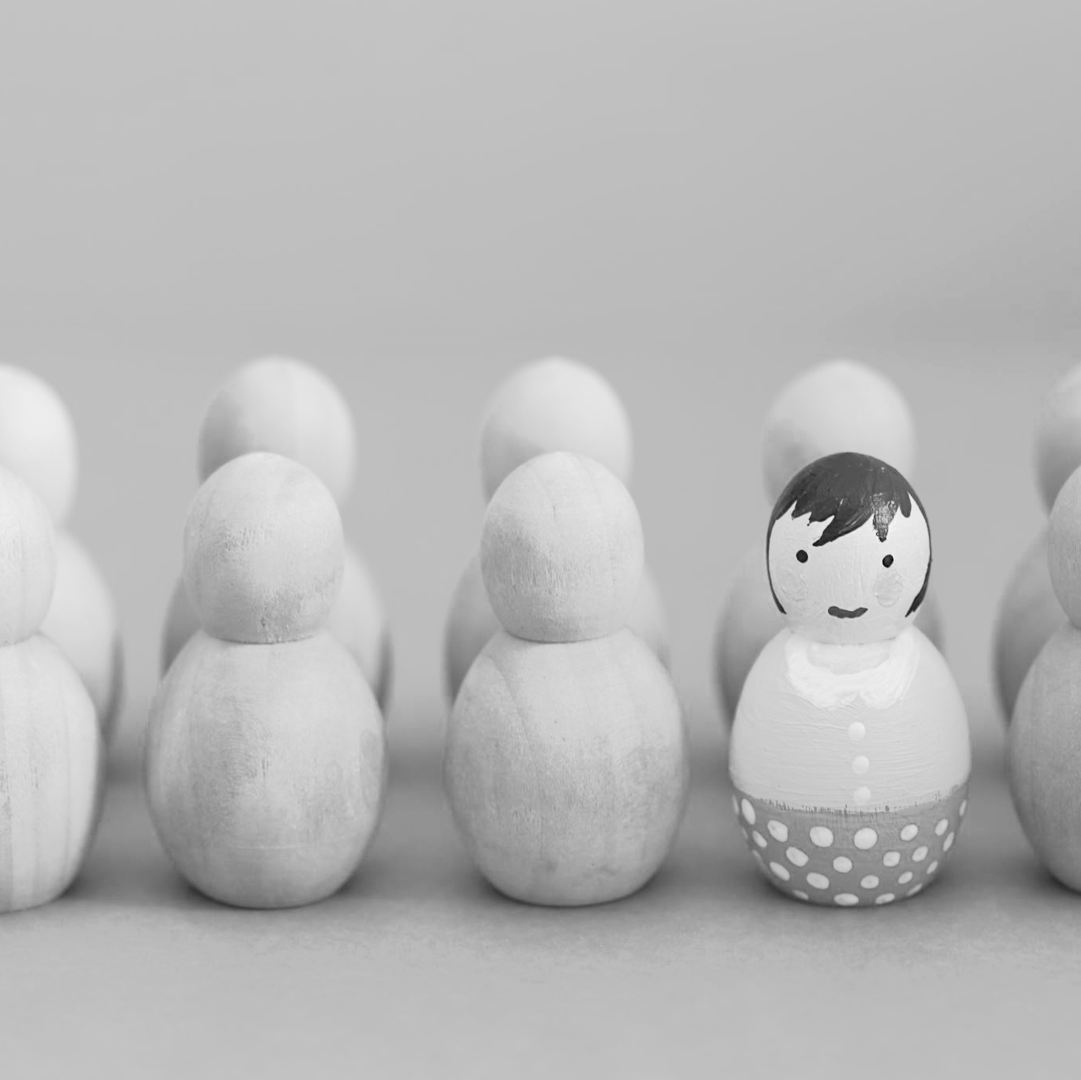
Outline of the Project
The Danish Girl (2000), If I Was Your Girl (2016) and Little Fish (2018).
‘While the pretender will never be read as female (and is thuss less of a threat), the deceiver passes seamlessly as a cissexual woman, fooling the men she dates into thinking she is a “real” woman’ (McAvan 2011: 24 cites Serrano 2007).
‘The wrong-body narrative outlines a standard telos, and any identity that fails to desire that telos is ruled ineligible. It restricts access to womanhood itself through hegemonic modalities’ (Bettcher 2014: 401).

Slide 3

Research Questions
To what extent are the texts transfeminist?
To what extent have the authors used ‘The Wrong Body Narrative’ to explain gender dysphoria?
What role does liminality play in trans narratives?
What is the relationship between gender and sexuality?
How do these texts challenge our understanding the trans subject as either a deceiver or pretender?

Slide 4
Theory and Methods
‘Transfeminism believes in the notion that there are as many ways of being a woman as there are women, that we should free to make our own decisions without guilt. Transfeminism confronts social and political institutions that inhibit our individual choices, while refusing to blame individual women for making whatever personal decisions’ (Koyama 2001: 3).
Liminality involves ‘moving from one side of the gender binary to the other on permanent basis’ (Wilson 2002: 438)

Slide 5

Progress and Next Steps
What have I done so far?
What will I do next?
‘I take full blame for the fact that this manifesto is heavily focused on issues on male-to-female transsexual people face. I felt the need to restrict the focus of feminism to “women” because I feared that expanding the focus would permit non-trans men to exploit feminism for their interest’ (Koyama 2001: 9).

Slide 6
References
Anderson, W. S (1998) Ovid's Metamorphoses. Oklahoma: University of Oklahoma Press
Bettcher, T. M. (2014) Trapped in the Wrong Theory: Rethinking Trans Oppression and Resistance. [online] available from <https://www.jstor.org/stable/10.1086/673088?seq=1#metadata_info_tab_contents> [25 February 2021]
Butler, J. (1990) Gender Trouble: Feminism and the Subversion of Identity. London: Routledge
Dentice, D. and Dietert, M. (2015) Liminal Spaces and the Transgender Experience. [online] available from <https://www.proquest.com/docview/1694707801?accountid=10286> [25 February 2021]
Ebershoff, D. (2015) The Danish Girl. London: Weidenfield & Nicolson
Entwistle, K. (2021) Debate: Reality Check – Detransitioner's Testimonies Require us to Rethink Gender Dysphoria. [online] available from <https://acamh.onlinelibrary.wiley.com/doi/full/10.1111/camh.12380> [27 February 2021]
Fiorilli, O. and Baldo, M. (2017) ‘Drag King Practices and the Struggle against Cis-normativity: Some Insights from the Italian Scenario’. in Reflections on Female and Trans* Masculinities and Other Queer Crossings. ed. by Kane, N. and Woods, J. Newcastle upon Tyne: Cambridge Scholars Publishing, 165-181
Koyama, E. (2001) Postscript for Catching A Wave: Reclaiming Feminism for the 21st Century. [online] available from <https://eminism.org/readings/pdf-rdg/tfmanifesto.pdf> [4 March 2021]
Koyama, E. (2001) Transfeminist Manifesto. [online] available from <https://eminism.org/readings/pdf-rdg/tfmanifesto.pdf> [25 February 2021]
McAvan, E. (2011) ‘Rhetorics of Disgust and Indeterminacy in Transphobic Acts of Violence’. in Homofiles: Theory, Sexuality, and Graduate Studies. ed. by Battis, J. Minneapolis: Lexington Books, 23-34
Plett, C. (2018) Little Fish. Vancouver: Arsenal Pulp Press
Putzi, J. (2019) “None of this ‘trapped-in-a-man’s-body’ bullshit”: Transgender Girls and Wrong-Body Discourse in Young Adult Fiction. [online] available from <https://muse.jhu.edu/article/677149> [25 February 2021]
Russo, M. (2016) If I Was Your Girl. London: Usborne Publishing
Shadyac, T. (1994) Ace Ventura: Pet Detective. [DVD] Los Angeles: Morgan Creek Entertainment
Wilson, M. (2002) `I am the Prince of Pain, for I am a Princess in the Brain': Liminal Transgender Identities, Narratives and the Elimination of Ambiguities. [online] available from <https://journals.sagepub.com/doi/10.1177/1363460702005004003> [26 February 2021]

Slide 7
Thank you for watching!
Do you have any questions?

